Slide 1

Four Wheel Steering
Adaptive Steering Solution
MAE 4287 Spring 2025
Presented 4/25/2025
Osama Almasri, Brad Kallam, Samatar Samatar, Tayden Carter, Sarbagnya Bhattarai

Slide 2
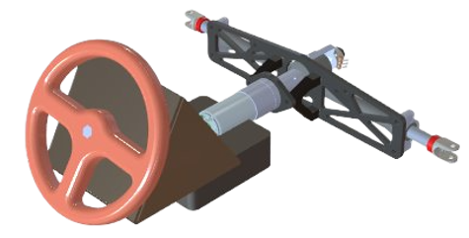
Introduction
Objective
Implement the four-wheel steering system on FSAE race car
Continuation of previous project group, Quad Steering Solutions
Electrically driven servo system for rear steer
Constraints/rules
6 degrees of turning
Integration with existing car, F16
Samatar 1

Slide 3
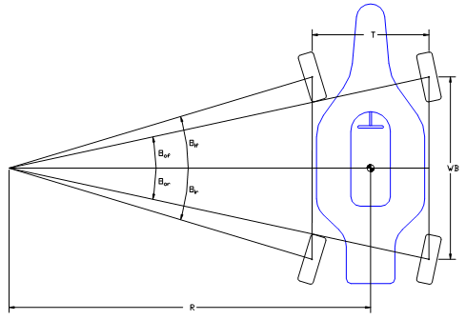
Theory
Parallel-steering
All four wheels turn in the same direction
High speeds
Counter-steering
Turn the rear wheels opposite of the front wheels
Low speed
This project will only focus on counter-steering
Small vs large steering inputs
Woods, Bob, “Four-Wheel Variable Counter Steering,”
Samatar 2

Slide 4
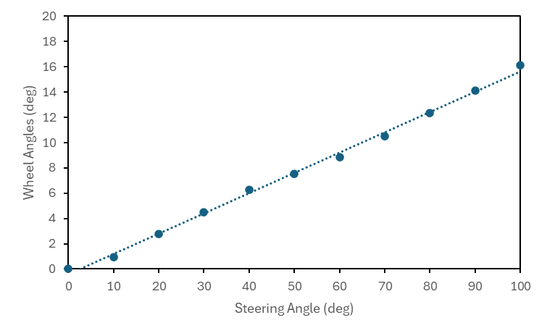
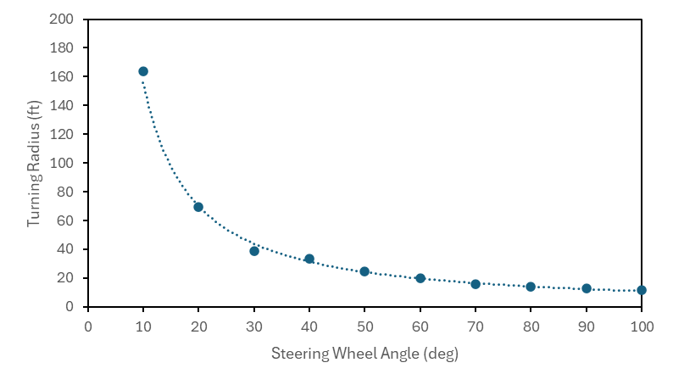
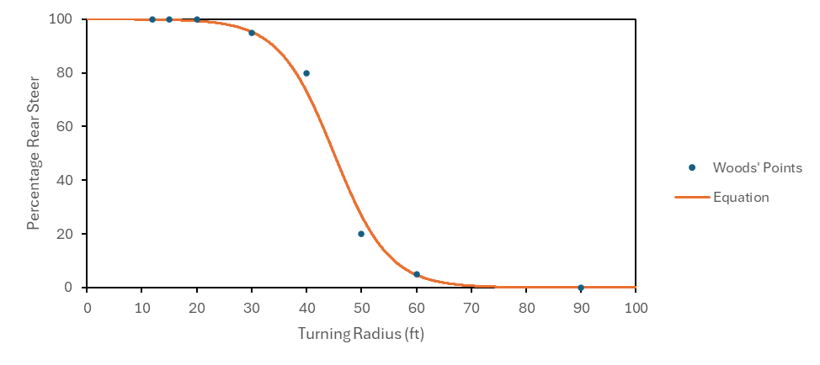
Approach
Turning Radius vs Percentage Rear Steer Equation
Steering Wheel Angle vs Front Wheel Angle on Car
Steering Wheel Angle vs Turn Radius Measured from F16
Bhattarai 3

Slide 5
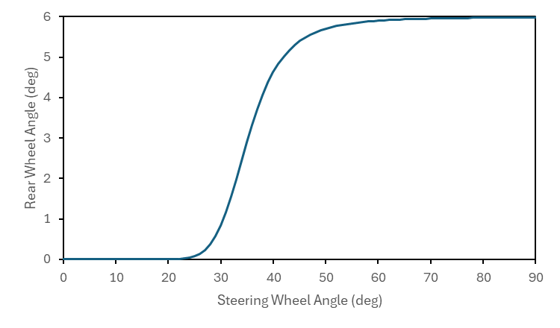
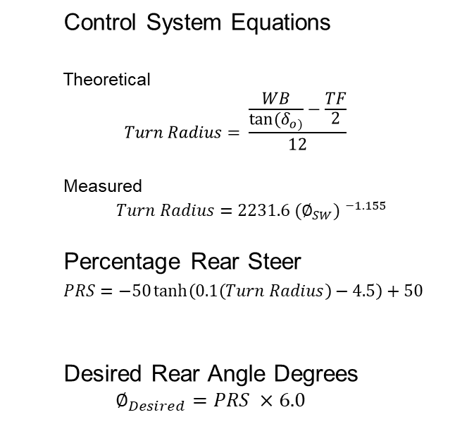
Equations
Control System Equations
Theoretical
$$Turn Radius= \frac{\frac{WB}{tan⁡(δ_{o)}}−\frac{TF}{2}}{12}$$
Measured
$Turn Radius=2231.6 {(∅_{SW}) }^{−1.155}$
Percentage Rear Steer
$PRS=−50\tanh\left(0.1\left(Turn Radius\right)−4.5\right)+50$
Desired Rear Angle Degrees
$$∅_{Desired}=PRS ×6.0$$
Bhattarai 4

Slide 6
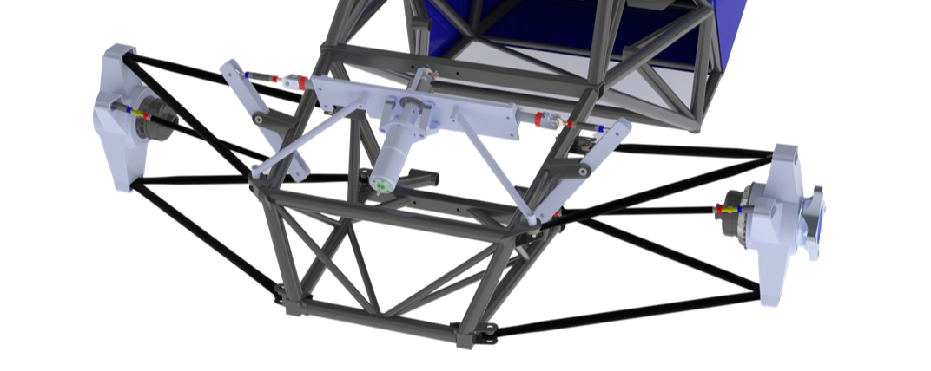
Suspension Modifications
Steering Rack
Upright
Steering Rack Chassis Mounts
Bell Crank
Almasri 5

Slide 7
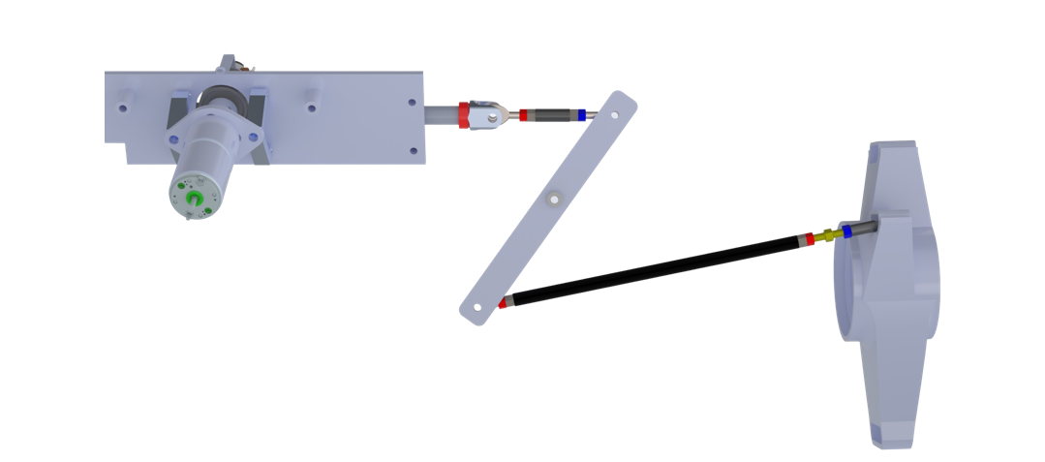
Suspension Modifications
Steering Rack Clevis
Inner Steering Rod
Upright Steering Arm
Pivot
Outer Steering Rod
Almasri 6

Slide 8
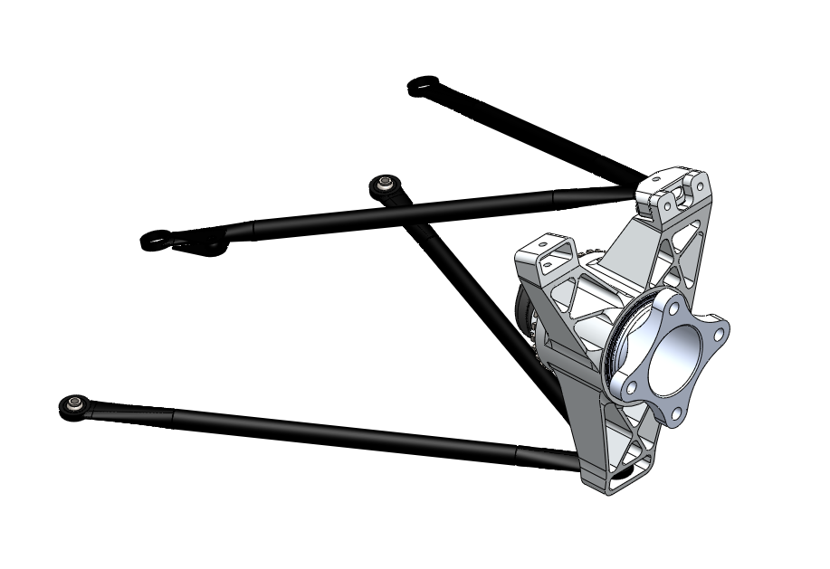
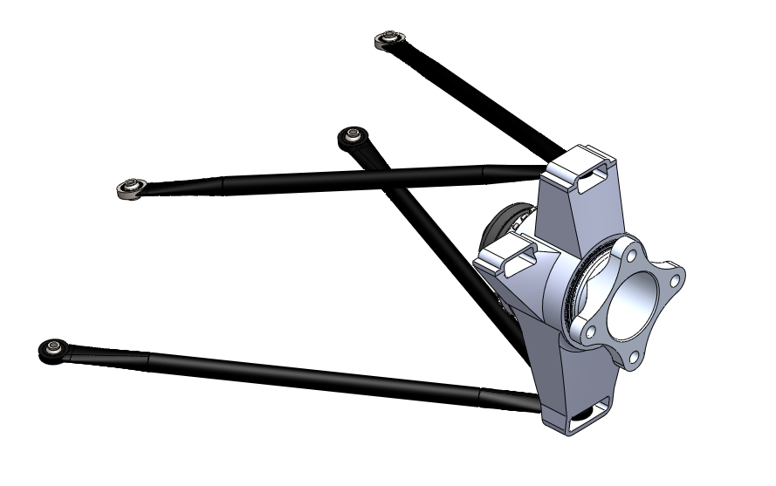
Suspension Modifications
Old Upright Design
New Upright Design
Almasri 7

Slide 9
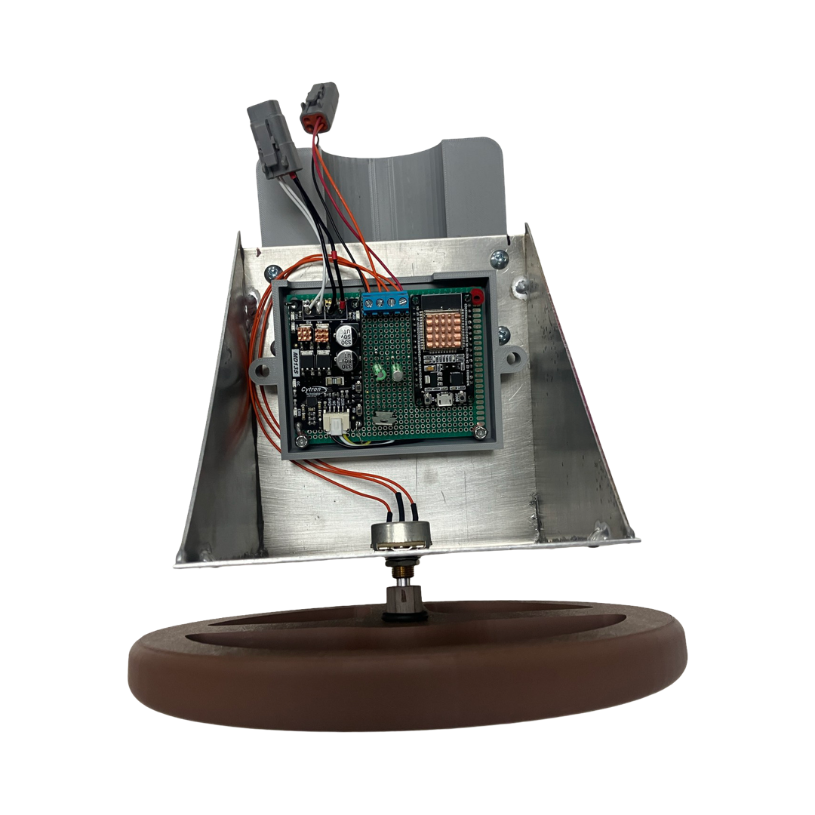
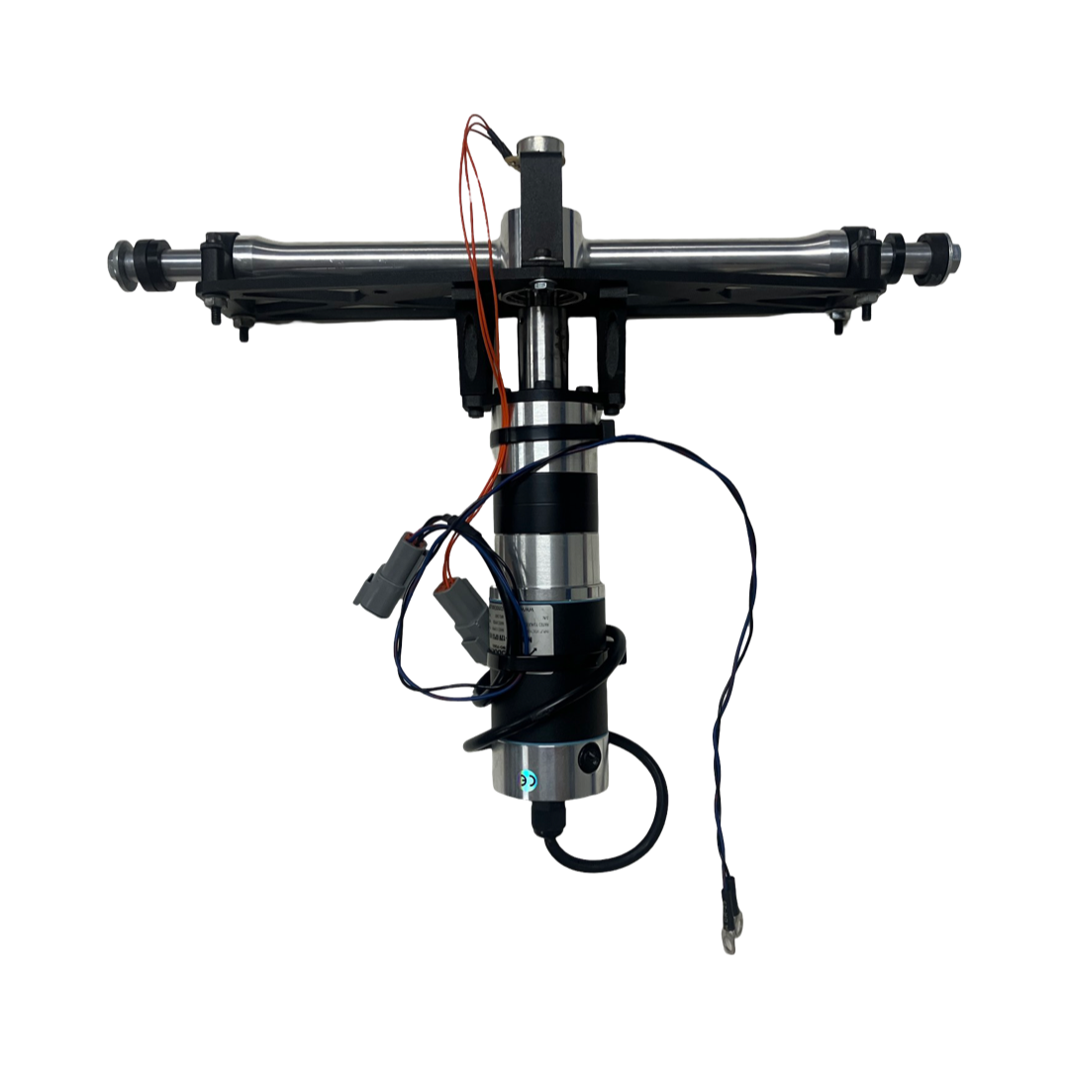
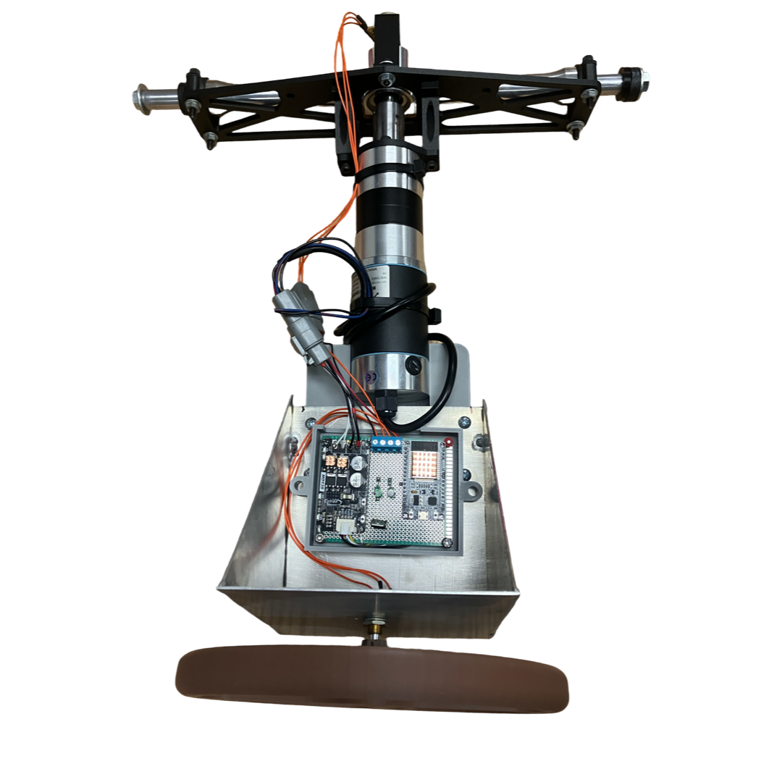
System Testbed
Steering Rack
Potentiometer
Includes:
Steering Rack
Servo Motor
Control Components
Electronics Board
Steering wheel mounted to potentiometer for user input
Electronics Board
Steering Wheel
Servo Motor
Potentiometer
Carter 8

Slide 10
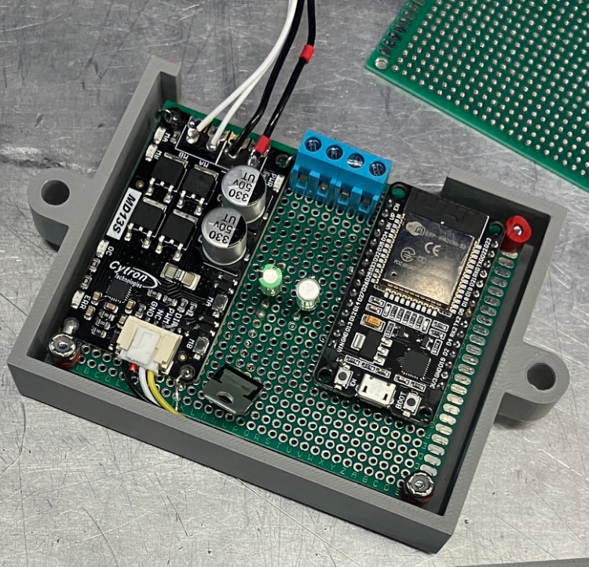
Control Component - Electronics
Potentiometer Terminal Block
ESP32 Microcontroller for its processing speed.
Sealed connectors and housing for automotive use
Ready to install on F16
MD13S Motor Driver
ESP32 Microcontroller
Carter 9

Slide 11
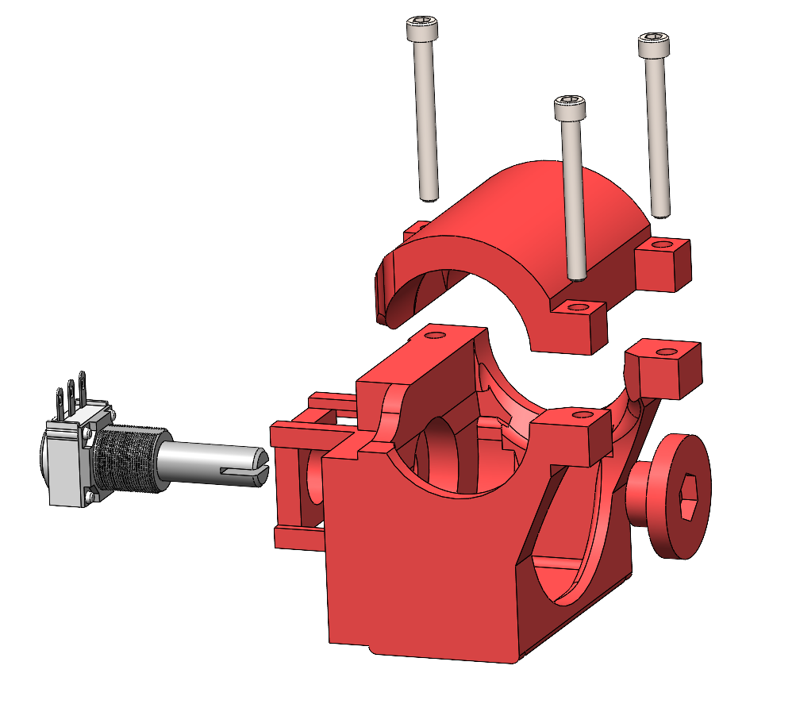
Control Components
Desired Rear Steer Position
Clamshell-type rack interface
Front steering position sensor
Input to Control System
Mounts to existing F16 front steering rack input shaft
Determines desired rear steering position
Front potentiometer
Steering shaft interface
Kallam 10

Slide 12
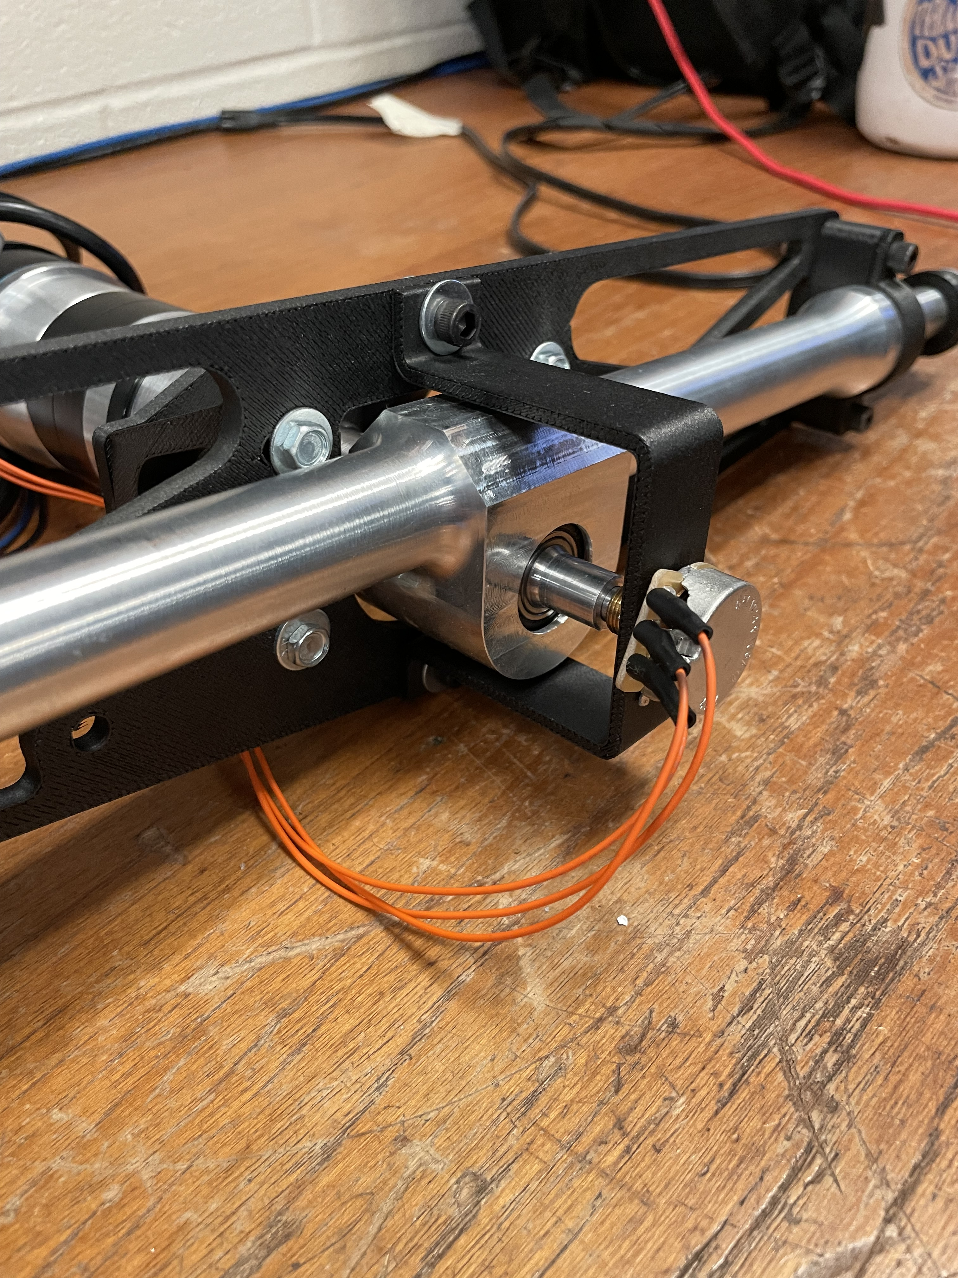
Control Components
Actual Rear Steer Position
Actual rear steering position determined using second potentiometer
Rear Steering Rack
Rear Potentiometer
Kallam 11

Slide 13
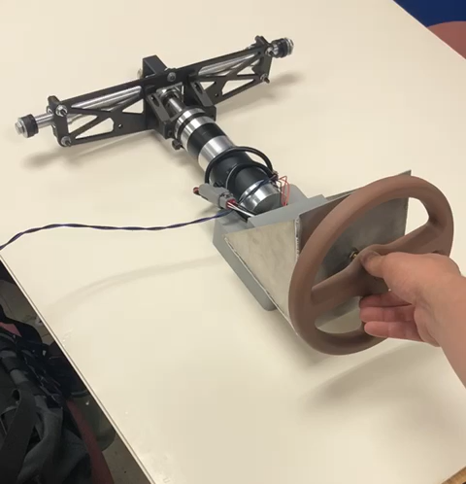
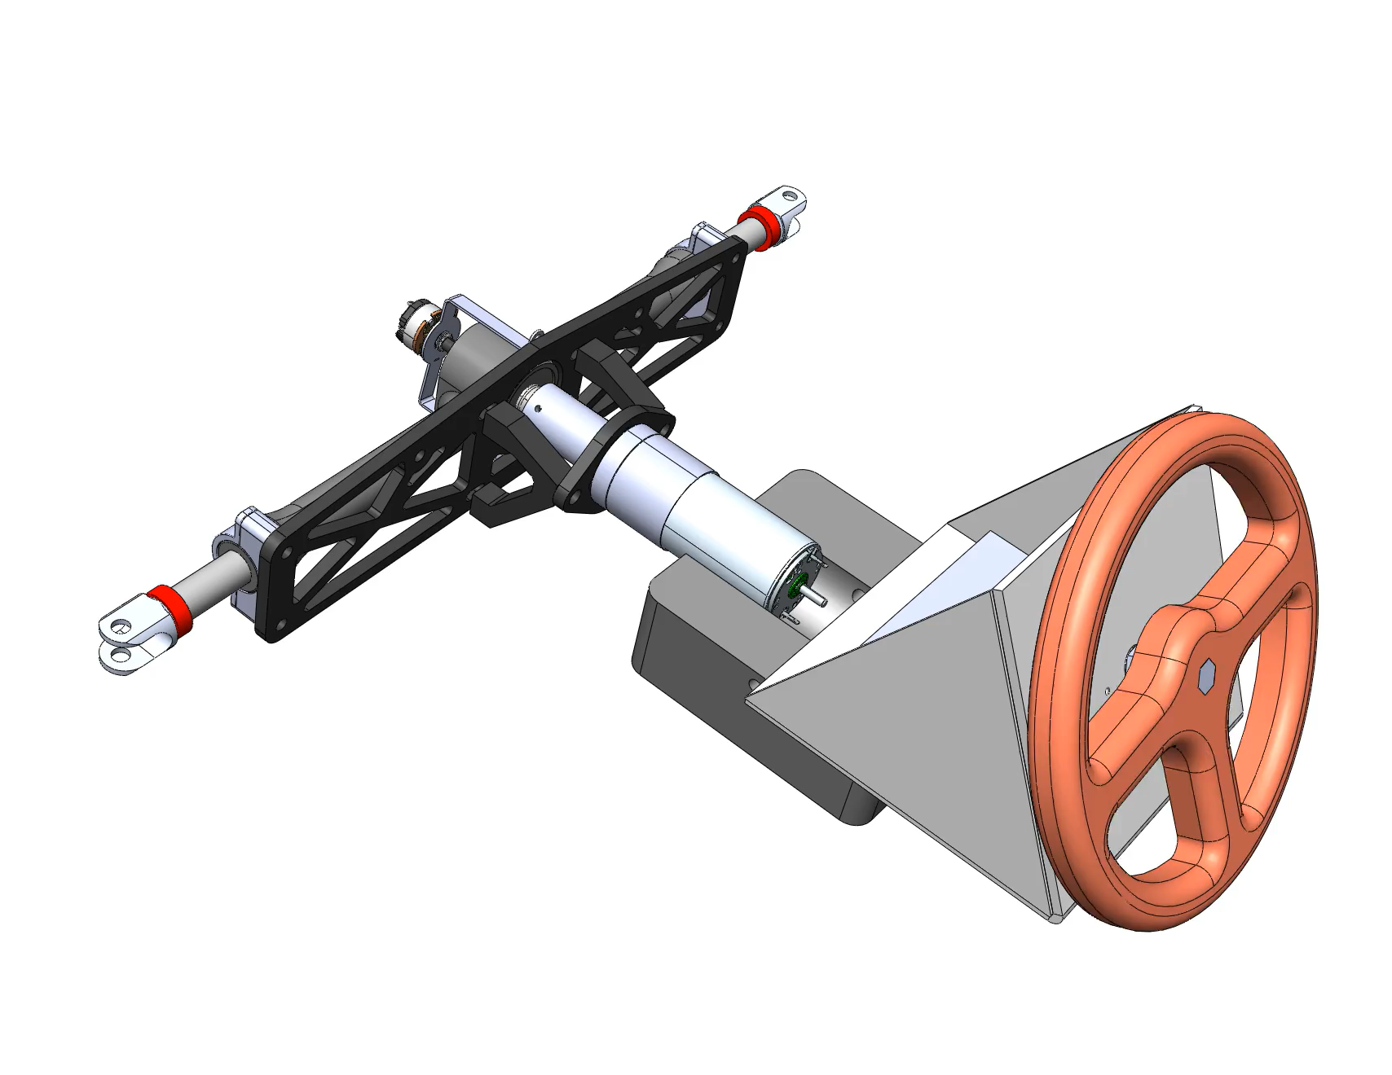
Testbed Demonstration
Kallam 12

Slide 14
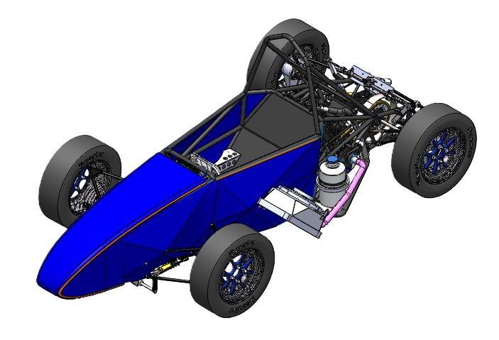
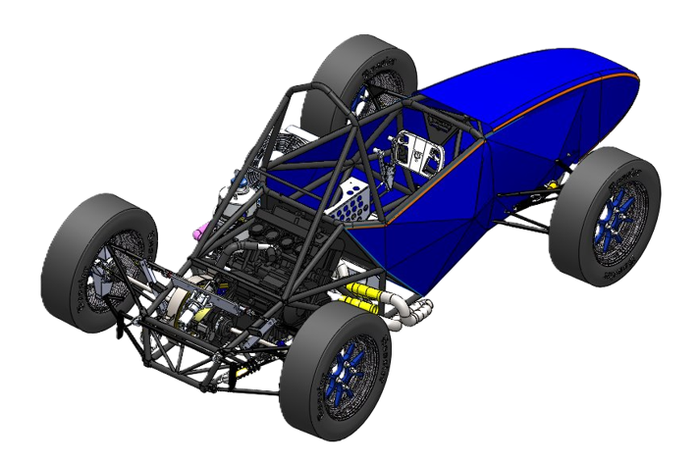
Questions?

Slide 16
Supplemental Information

Slide 17
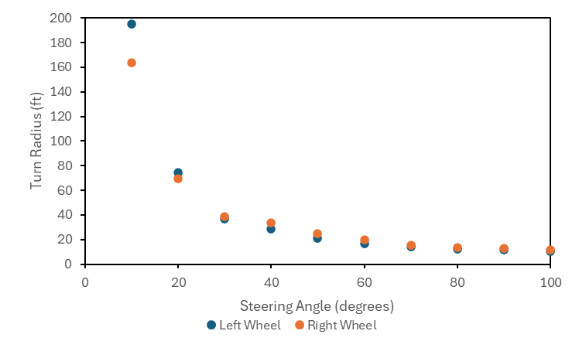
Supplemental Information – Turn Radius

Slide 18
Supplemental Information – PD Strategy
Control Component – Closed Loop Feedback
PD type feedback loop used to align desired rear steering position and actual rear steering position
Desirable characteristics:
Minimize overshoot of desired position
Minimize oscillation
Maximize response to change in desired position
Maintain steering angle with varying wheel load
Kallam 14

Slide 19
Supplemental Information - Code
The code was designed to be easily adjusted and adaptable for future implementation.
Wrote in C as it is a pre-compiled language meaning faster computing speed and more control over the memory and hardware
The measured values for the car are stored as variables therefore when changes are made the code is quick to adjust

Slide 20
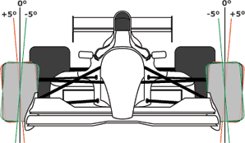
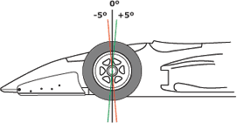
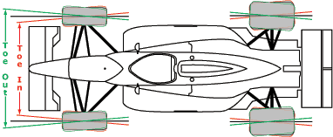
Camber Angle
Caster Angle
Toe Angle
Source:TireRack

Slide 21
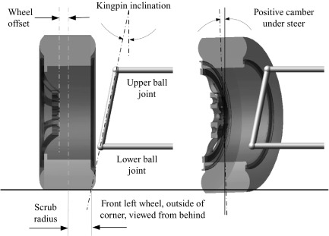
King Pin Inclination
Bump Steer
Source: wikimedia commons

Slide 22
Reference
[1]. Woods, Bob, “Four-Wheel Variable Counter Steering,” February 20, 2022, UTA Internal Documentation, file: “Four-Wheel Variable Counter Steering.docx”

